Slide 1


PyPen
Mohamad Hashem,IEEE; Oussama Kheireddine,IEEE Mohamad Hussam Hodaifa,IEEE;
Project Advisor: Dr. Charbel Boustany, PhD
Department of Information and Communications Technology
Faculty of Arts and Sciences.
https://github.com/mohamadhachem/Senior-Project.git

Slide 2
Presentation Overview
INTRODUCTION AND BACKGROUND
PROBLEM STATEMENT
EXISTING SOLUTIONS
PROPOSED SOLUTION
DESIGN & IMPLEMENTATION
LIMITATIONS
TESTING AND VALIDATION

Slide 3
PROBLEM STATEMENT
It can be really messy and tricky.
Mistake may happen which leads to loosing valuable assets.
Time consuming.
Software limitation.

Slide 4
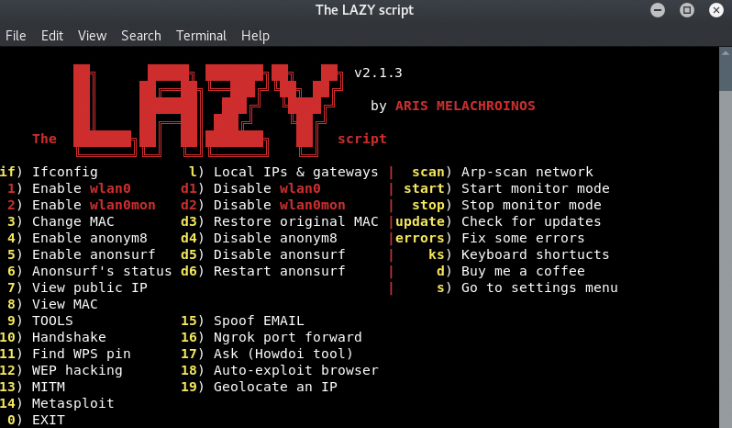
EXISTING SOLUTIONS
The Lazy Script
Is a framework of penetration tools that offers variety of attacks
Easy to navigate and install
Automates process involved in Wifi Penetration Testing and Hacking

Slide 5
Advantages:
Easy to navigate
Offers variety of attacks and scripts
Executes the attack with a minimum of interaction from the user
Dedicated to Penetration testers
Disadvantages:
Ambiguous for beginner
Operates on one platform only (kali Linux)
Dull looking

Slide 6
PROPOSED SOLUTION
PyPen
Is a GUI application that runs on Linux, Mac, IoS, Android and windows using python’s PyQt framework, Which is a combination of python version 2 & version 3 bindings from Qt company.
PyPen contains a set of predefined scripts, that assist the user in his journey.

Slide 7
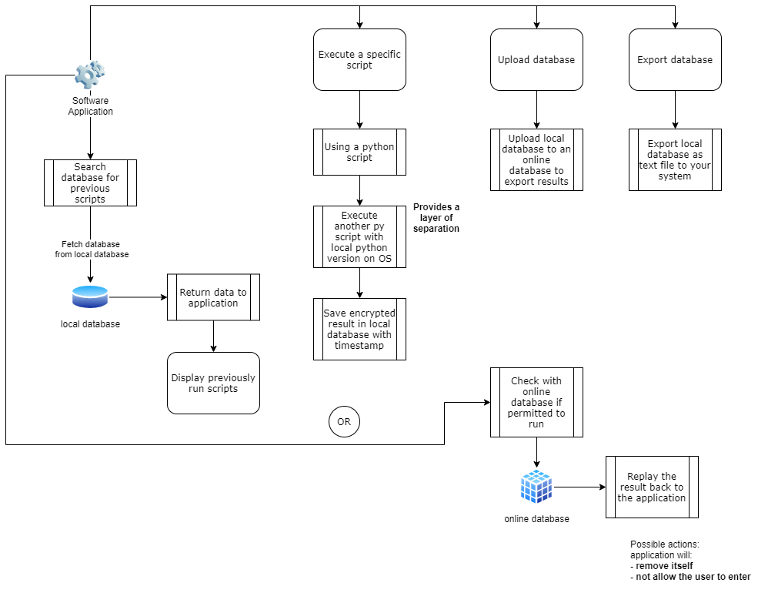
DESIGN & IMPLEMENTATION
System Architecture

Slide 8
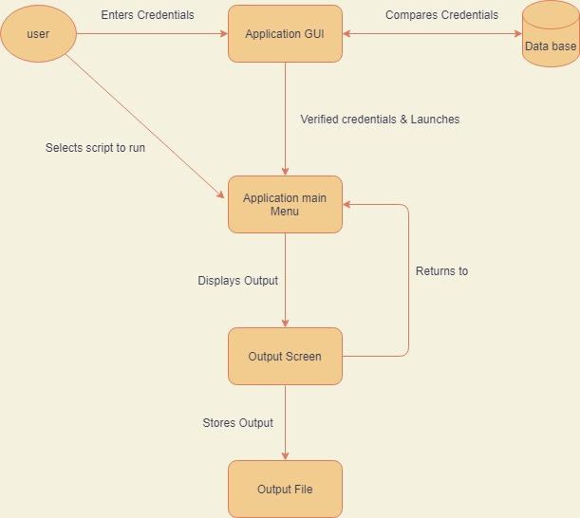
DFD Diagram

Slide 9
IMPLEMENTATION
PyQT
In order to achieve a very friendly user interaction, with GUI buttons, PyQT framework is one of many good ways to do so. the amount of interaction between the user and the app will be increased
There are many software modules that can generate GUI interfaces for example Tkinter but not all modules achieve advanced programming results like PyQT.

Slide 10
PyQT advantages
Qt offers several widgets, such as buttons or menus, across all supported platforms.
Qt also offers Qt designer which is less time consuming, and much easier to use.
Qt uses a wide array of native platform APIs for the purpose of networking, database creation, and many more.

Slide 11
LIMITATIONS
Software Limitation
Cannot run on many platforms
Not readable for beginners
No graphics
Not easy to be modified
Hard access for log files

Slide 12
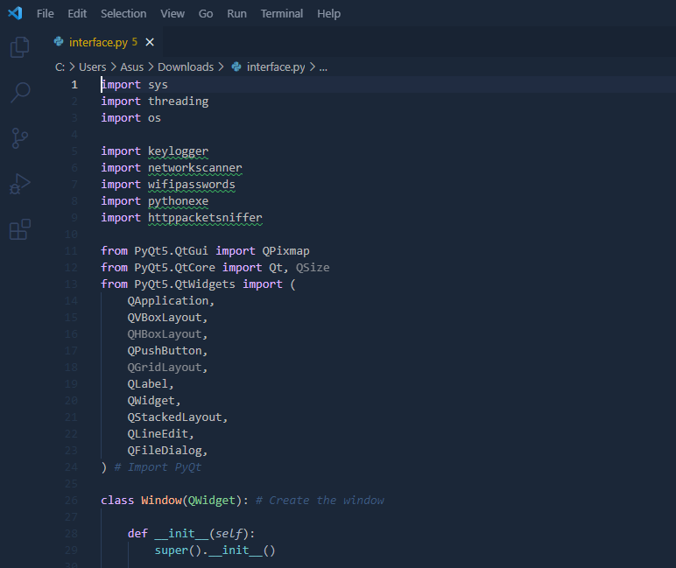
TESTING AND VALIDATION
The Interface

Slide 13
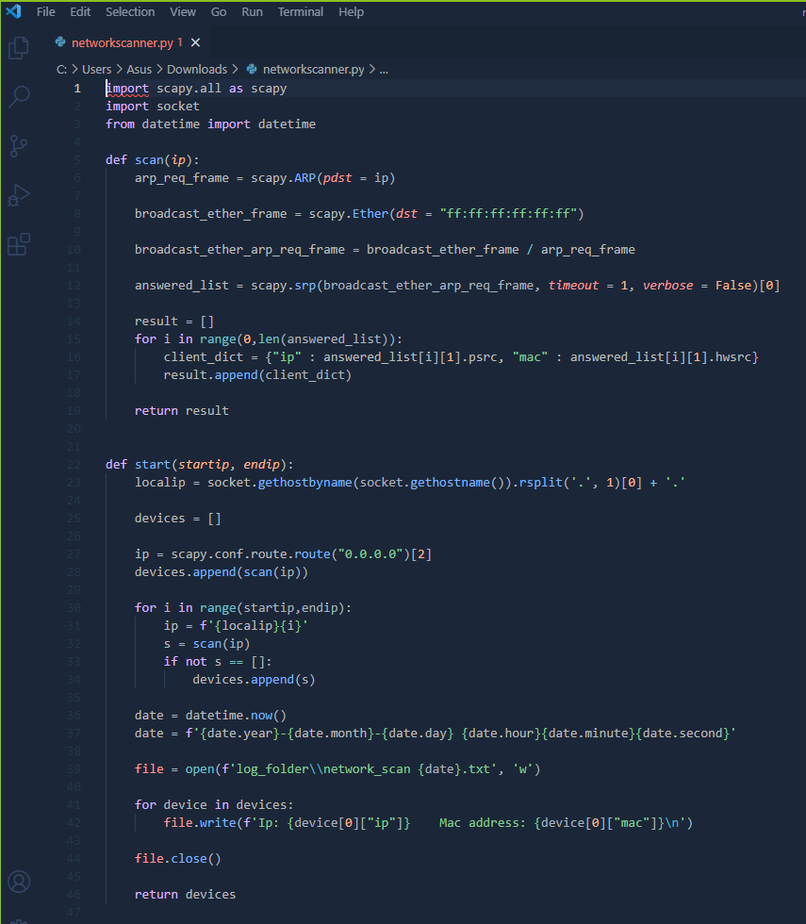
Network scanner

Slide 14
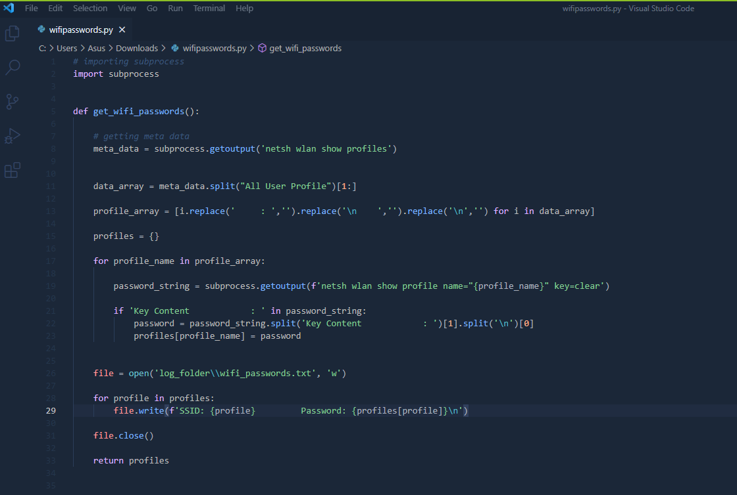
Wifi Passwords

Slide 15
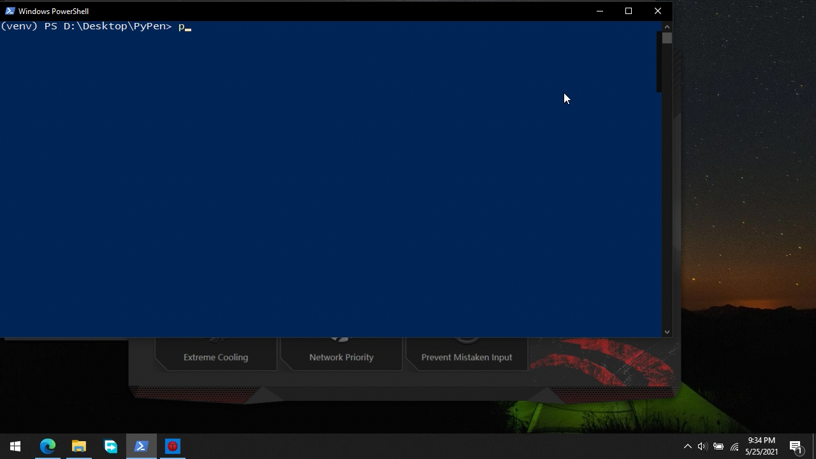
PyPen Live Demo.

Slide 16
Thank you !
GitHub link:
https://github.com/mohamadhachem/Senior-Project.git

